Slide 1
High Speed memory: Memory Interleaving

Slide 2
Main Memory
Bottom of the memory hierarchy
Measured in
Access Time
Time between a read is requested and data delivered
Cycle Time
Minimum time between requests to memory
Time may be required for the memory to “recover” before the next access
Greater than access time to ensure address lines are stable
Three Important Issues
Capacity
Bell’s law - 1 MB per MIP needed for balance, avoid page faults
Latency
Time to access the data
Bandwidth
Amount of data that can be transferred or affects the time it takes to transfer the block

Slide 3
DRAMS
Dynamic RAM
Transistor stores each bit
Loss over time
Must periodically “refresh” the bits
All bits in a row can be refreshed by reading that row
Memory controllers periodically refresh, e.g. every 8 ms
If the CPU tries to access memory during the refresh, we must wait (hopefully won’t occur often)
Typical cycle times 60-90ns

Slide 4
SRAMs
Static RAM
Does not need a refresh
Faster than DRAM, generally not multiplexed
But more expensive
Typical memories
DRAM 4-8 times the capacity of SRAM
Used for main memory
SRAM 8-16 times faster than DRAM
Typical cycle times 4-7ns
Also 8-16 times as expensive
Used to build cache
Exceptions; Cray built main memory out of SRAM

Slide 5
Memory Technology
SRAM’s and DRAM’s are different
• DRAM: 1 transistor/bit; SRAM: 4-6 transistors/bit
• DRAM capacity is 4-8 times that of SRAM at same feature size
• SRAM speed is 8-16 times that of DRAM but cost is as much
Main memory today means DRAM
• Multiplexed address lines - row and then column access
• 2 dimensional address - rows go to a buffer and subsequent column selects sub row
• Refresh needed every few milliseconds

Slide 6
Memory Example
Consider the following scenario
4 cycles to send the address
24 cycles to access a word in the memory unit
4 cycles to transmit the data
Hence if main memory is organized by word , then 32 cycles for every word is spent
Given a cache block size of 4 words
= 32 *4 = 128 cycles is the miss penalty
Clearly we need a better organizational model - Memory Organization Improvements

Slide 7
#1 : More Bandwidth to Memory
Make a word of main memory look like a cache line
Easy to do conceptually
Say we want 4 words, so send all four words back on the bus at one time instead of one after the other
Problem is the cost of the wider bus between cache and MM
Problem
Need a wider bus, which is expensive
Usually the bus width to memory will match the width of the L2 cache

Slide 8
Interleaved Memory
Memory interleaving increases bandwidth by allowing simultaneous access to more than one chunk of memory.
This improves performance because the processor can transfer more information to/from memory in the same amount of time and helps alleviate the processor-memory bottleneck that is a major limiting factor in overall performance.

Slide 9
Interleaving works by dividing the system memory into multiple blocks. The most common numbers are two or four, called two-way or four-way interleaving
In order to get the best performance from this type of memory system, consecutive memory addresses are spread over the different blocks of memory.
It uses all 4 blocks, spreading the memory around so that the interleaving can be exploited.

Slide 10
It is most helpful on high-end systems,
especially servers, that have to process a great deal of information quickly.
The Intel Orion chipset is one that does support memory interleaving.

Slide 11
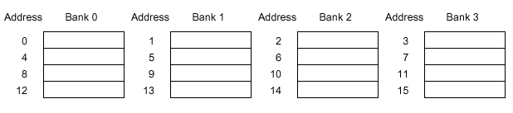
Interleaved Memory Banks
Take advantage of potential parallelism by interleaving memory
Bus bandwidth is the same but we make it work more often
4-way interleaved memory
Allow simultaneous access to data in different memory banks then each deliver one word to bus interleaving
Good for sequential data

Slide 12
Interleaved memory
Interleaved memory is a technique for compensating the relatively low speed of DRAM.
The CPU can access alternative sections immediately without waiting for memory to be cached. Multiple memory banks take turns supplying data.
An interleaved memory with "n" banks is said to be n-way interleaved.
If there are "n" banks, memory location "i" would reside in bank number i mod n.

Slide 13
Main memory is composed of a collection of DRAM memory chips. A number of chips can be grouped together to form a memory bank. It is possible to organize the memory banks in a way is know as interleaved memory.
Interleaved memory is one technique for compensating for the relatively slow speed of dynamic RAM (DRAM). Other techniques include page-mode memory and memory caches.

Slide 14
Interleaving
Process used to divide the shared memory address space among the memory modules
Two types of interleaving
High-order
Low-order

Slide 15
High-order Interleaving
Shared address space is divided into contiguous blocks of equal size.
Two high-order bits of an address determine the module in which the location of the address resides.
Hence the name High-order Interleaving

Slide 16
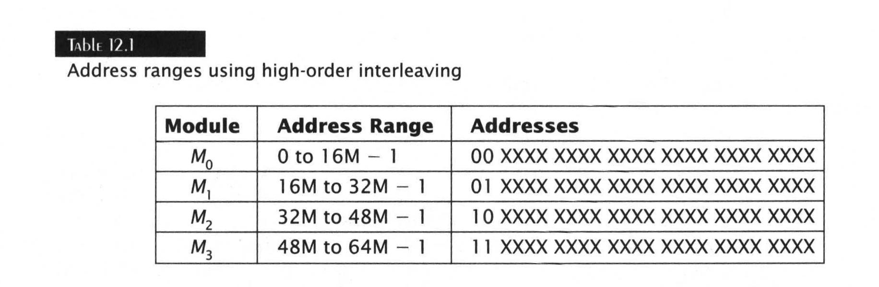
Example of 64 Mb shared memory with four modules

Slide 17
High-Order Interleaving (HOI)
Address Format
n bits
bank/module address m bits | word in the bank/module (n-m) bits
Module 0
Module 1
Module 2
Module 3
0
1
2
3
4
5
6
7
8
9
10
11
12
13
14
15

Slide 18
Example 3
Memory capacity = 64 or 2⁶→ no of address bit = 6
Total main module/bank = 4 or 2² → 2 bits to address module/bank
No of bits for word in module/bank = 6 – 2 = 4 → module/bank capacity = 2⁴ = 16
Since these are high order bits, therefore its called HOI
001111
15
M0
0
011111
31
M1
16
101111
47
M2
32
111111
63
M3
48
000001
000000
010001
010000
100001
100000
110001
110000
These bits are same in all 4 modules.

Slide 19
Advantages of HOI
Easy memory extension by the addition of one or more memory modules to a maximum of M-1.
Provides better reliability, since a failed module affects only a localized area of the address space.
This scheme would be used w/o conflict problems in multiprocessors if the modules are partitioned according to disjoint or non-interleaving processes( programs should be disjoint for its success).

Slide 20
Low-order Interleaving
Low-order bits of a memory address determine its module

Slide 21
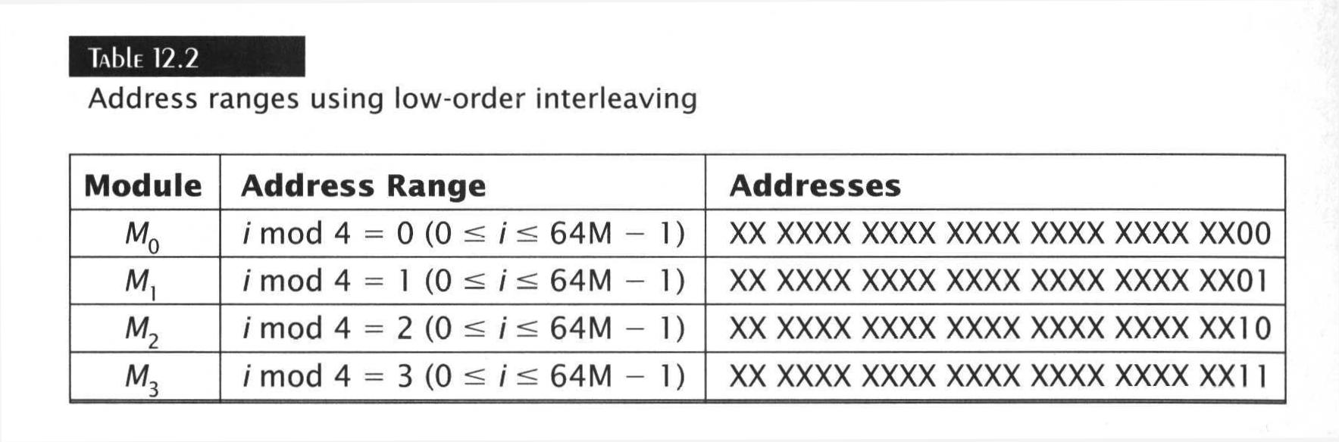
Example of 64 Mb shared memory with four modules

Slide 22
Low-Order Interleaving (LOI)
Address Format
n bits
word in the bank/module (n-m) bits | bank/module address m bits
Module 0
Module 1
Module 2
Module 3
0
4
8
12
1
5
9
13
2
6
10
14
3
7
11
15

Slide 23
Example 1
Memory capacity = 64 or 2⁶→ no of address bit = 6
Total main module/bank = 4 or 2² → 2 bits to address module/bank
No of bits for word in module/bank = 6 – 2 = 4 → module/bank capacity = 2⁴ = 16
Since these are low order bits, therefore its called LOI
111100
60
M0
4
0
111101
61
M1
5
1
111110
62
M2
6
2
111111
63
M3
7
3
000100
000000
000101
000001
000110
000010
000111
000011
These bits are same in all 4 modules.

Slide 24
Low-order Interleaving (cont.)
Low-order interleaving originally used to reduce delay in accessing memory
CPU could output an address and read request to one memory module
Memory module can decode and access its data
CPU could output another request to a different memory module
Results in pipelining its memory requests.
Low-order interleaving not commonly used in modern computers since cache memory

Slide 25
Low-order vs. High-order Interleaving
In a low-order interleaving system, consecutive memory locations reside in different memory modules
Processor executing a program stored in a contiguous block of memory would need to access different modules simultaneously
Simultaneous access possible but difficult to avoid memory conflicts

Slide 26
Low-order vs. High-order Interleaving (cont.)
In a high-order interleaving system, memory conflicts are easily avoided
Each processor executes a different program
Programs stored in separate memory modules
Interconnection network is set to connect each processor to its proper memory module

Slide 27
Advantages & Disadvantages (LOI)
Advantages
It produces memory interference.
Disadvantages
A failure of any single module would be catastrophic to the whole system.

Slide 28
Associative Memory
Associative Memory is also called as Content Addressable Memory because its memory unit is accessed by its content.
Associative Memory is mostly used in Application . The disadvantage of this memory is that it is very costly as compared to RAM(Random Access Memory) but its storage area is good.

Slide 29
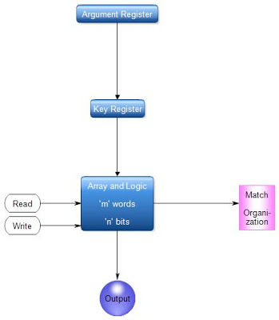
Block Diagram of Associative Memory:-
Notes:
Humans learn and recall information much more easily if it is associated with prior knowledge. Information that is related to other content is far easier for humans to recall. Associative memory in computers is based on this same principle. Read more : http://www.ehow.com/facts_7259977_associative-memory-computer-organizaton_.html

Slide 30
Block Diagram consists:-
1)Argument Register. 2)Key Register. 3)Array&Logic of Computer. 4)Match Register.

Slide 31
It comprises of a memory array and logic for m words with n bits per word. Argument register A and key register K both have n bits, one for every bit of a word. Match register M has m bits, one for each memory word.
Every word in memory is compared in parallel with content of argument register then the words which match the bits of argument register set a corresponding bit in match register.

Slide 32
To explain with a numerical illustration assume that argument register A and key register K have the bit configuration displayed below. Only three leftmost bits of a compared with memory words since K has 1's on these positions.
A 101 111100
K 111 000000
Word 1 100 111100 no match
Word 2 101 000001 match
Word 2 matches unmasked argument field since the three leftmost bits of argument and word are equal.

Slide 33
An associative memory is more expensive than RAM, as each cell must have storage capability as well as logic circuits for matching its content with an external argument.

Slide 34
Associative memory can be directly accessed by the content rather than the physical address
When a word is written in a Associative Memory then no address, name, relative position is given.
Associative memory is also capable to find the unused or empty location to store words. In Associative memory each cell has storage capability as well as logic circuit.

